Slide 1
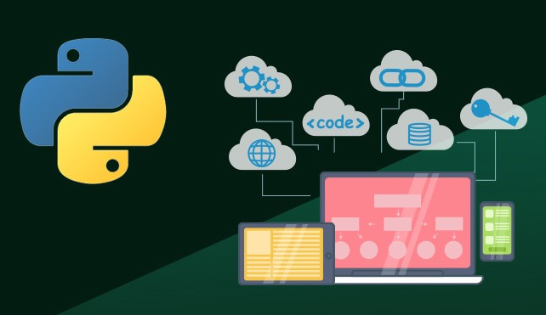
Python Web Development
Dr. Reza Dibaj

Slide 2
Outline
Introduction
Why using Python for Web Development?
Python Web Development Libraries
Python and Django
Django Installation for PyCharm
Sample Web Application Demo
Just a bit of Flask
What is REST API?

Slide 3
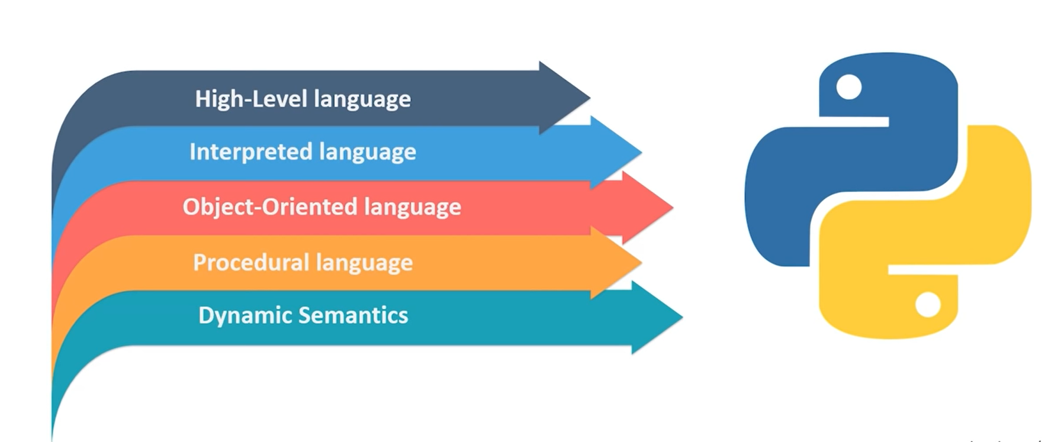
Introduction
Notes:
Interpreted High-level Language
-OOP
-Procedural (sequential) Manner
Dynamic typing & Dynamic binding semantics
Web Development: Task of web developing websites that can be hosted by internet.
It varies from a simple page to complex websites.

Slide 4
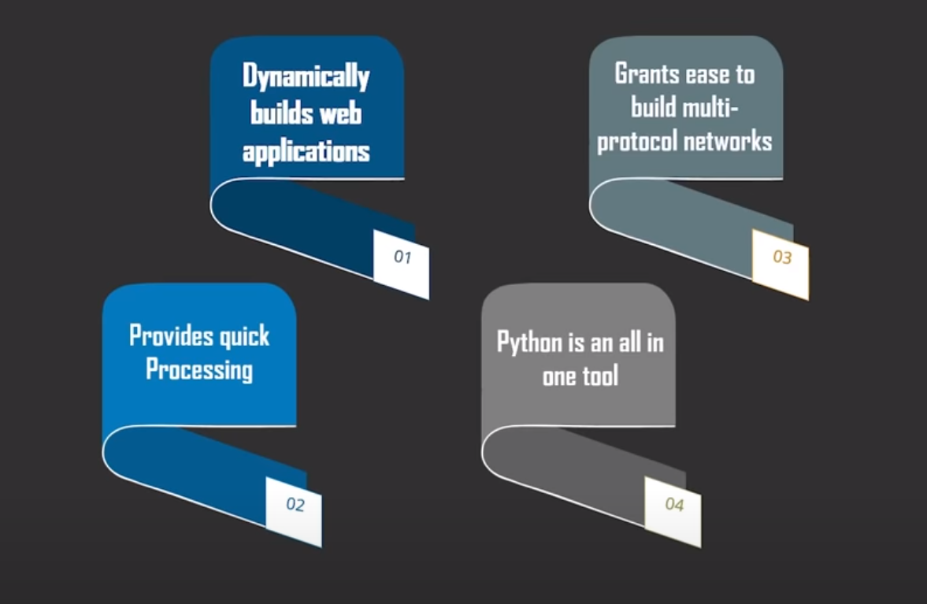
Why using Python for Web Development?
Notes:
1- Python allows you to Build applications dynamically
2- Grants you to build multi-protocol network application
3 & 4- Python is Flexible, & easy to use language, and provides quick processing environment, and it contains many libraries. These are some of the features that make Python an attractive option for every applications, including Web Development.

Slide 5

Python Web Development Libraries

Slide 6
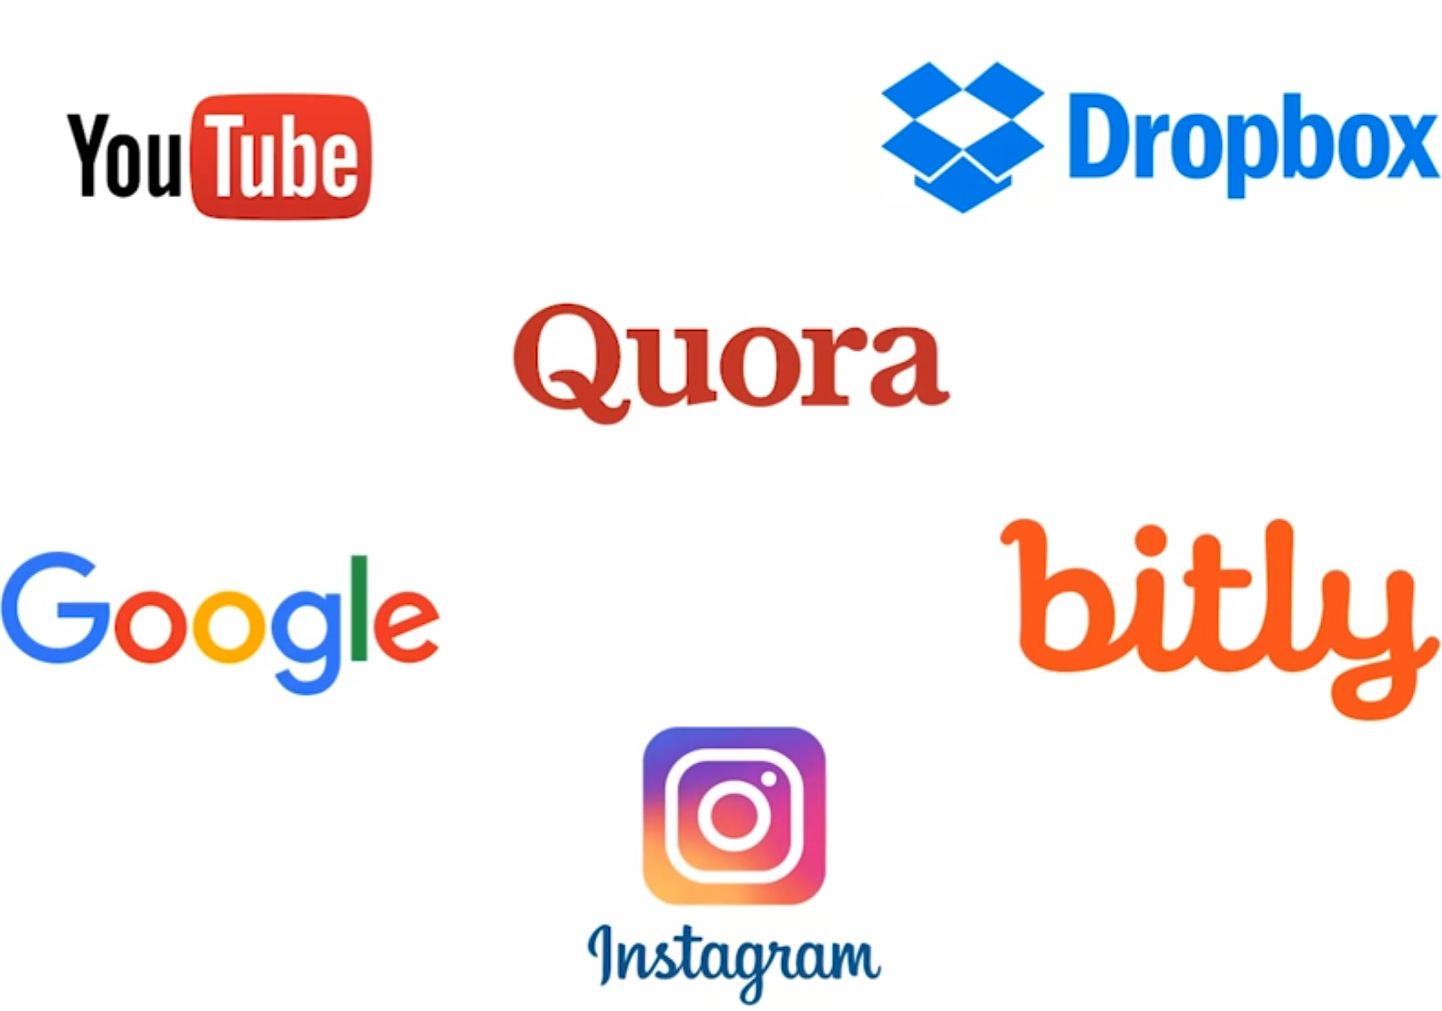
Python and Django
Purely written in Python & Fast
Fully loaded with all the required tools to create a website
Very Secure
Notes:
One of the best Python Libraries for Web Development
Purely written in Python & Fast: Creating an entire website in a few hours
YouTube, Dropbox, Quora, Google, bitly, and Instagram… All these internet giants rely on Django.

Slide 7
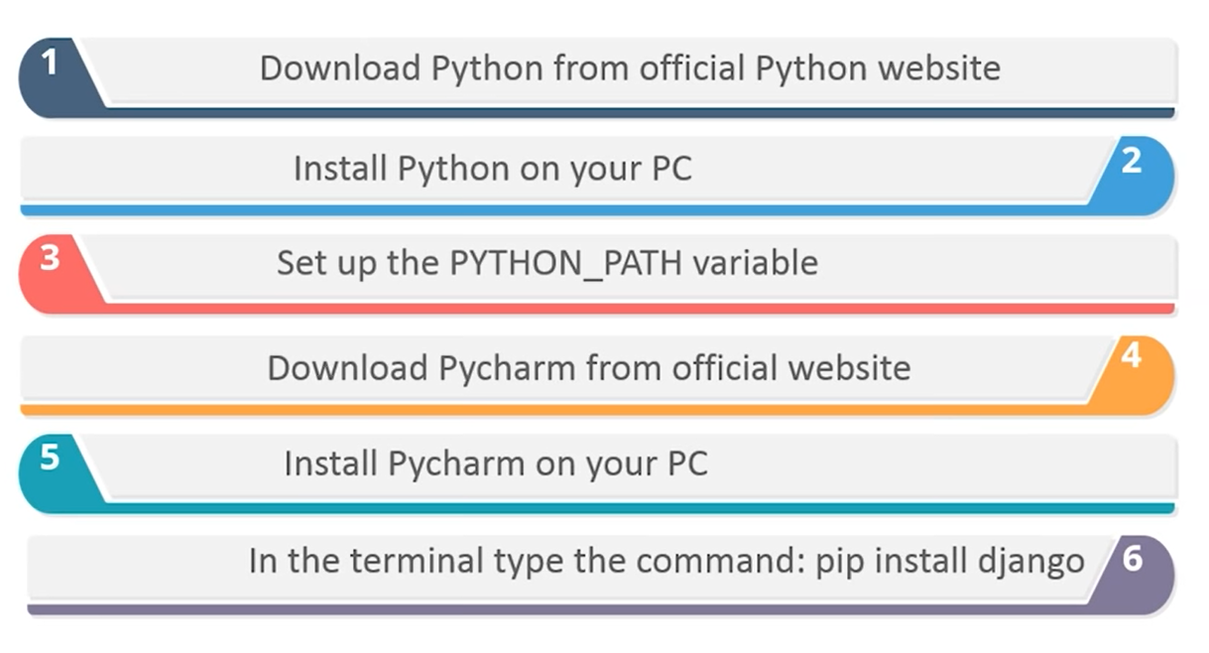
Django Installation for PyCharm

Slide 8
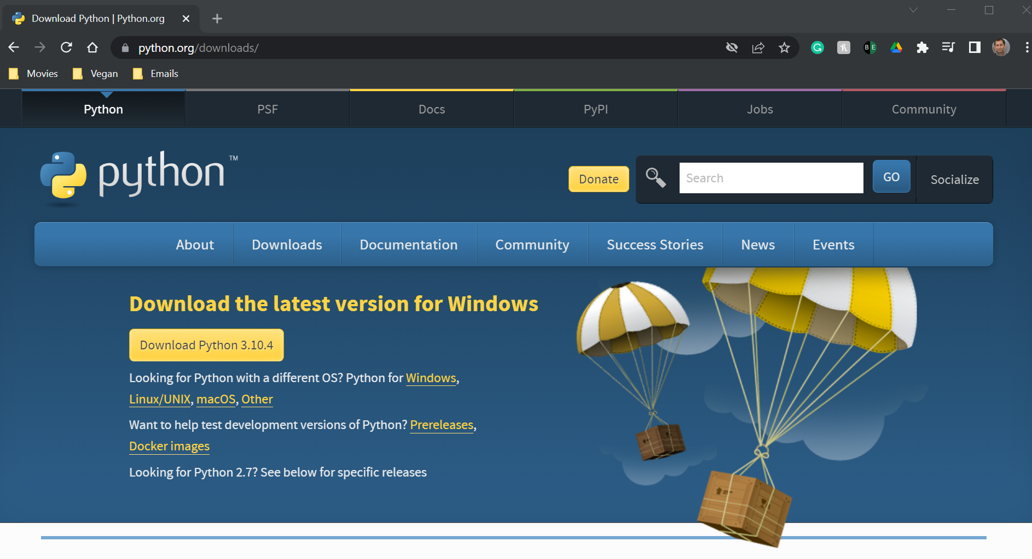
Django Installation for PyCharm
Notes:
https://www.python.org/downloads/

Slide 9
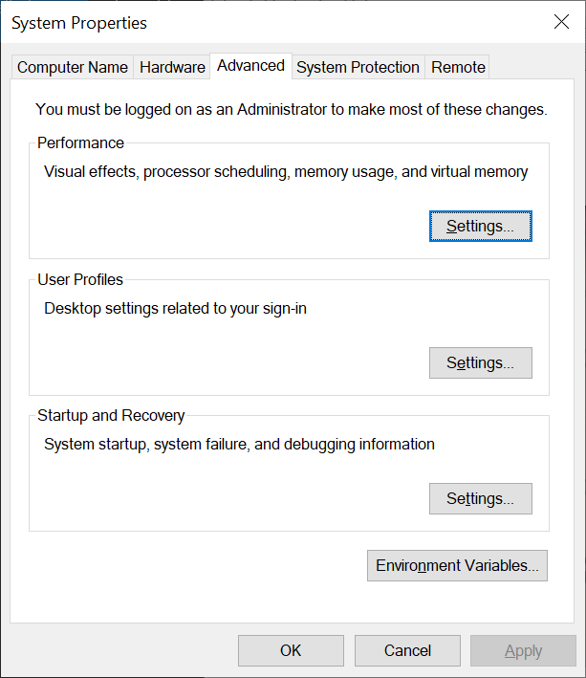
Django Installation for PyCharm
Advanced system settings

Slide 10
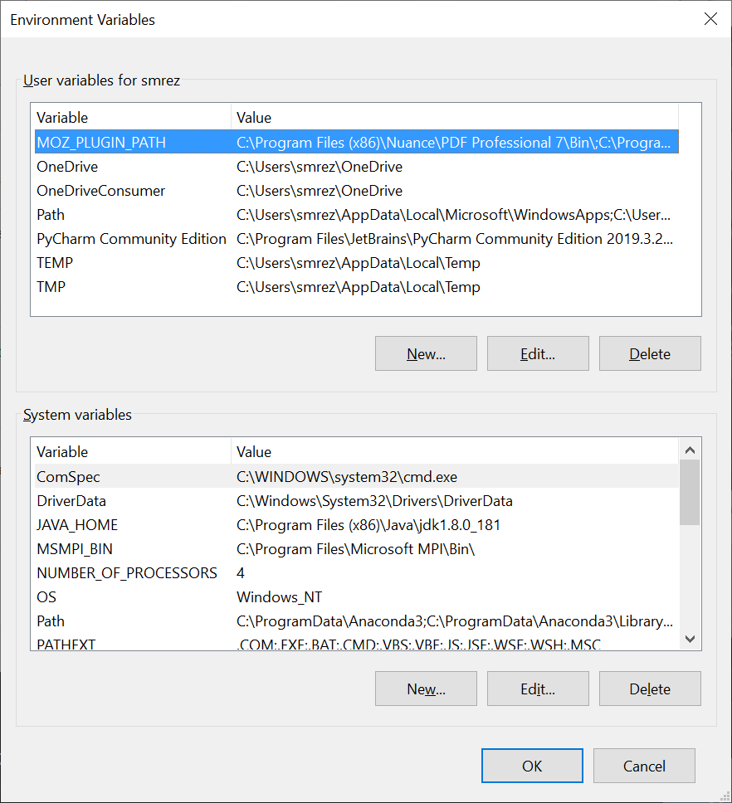
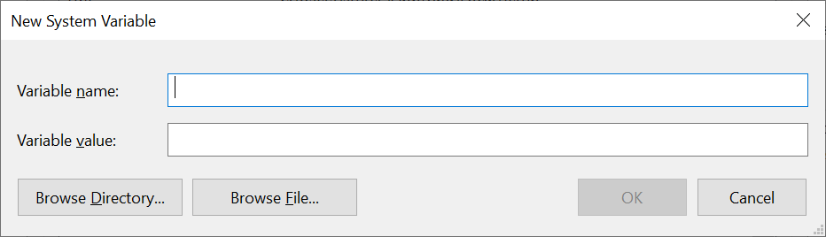
Django Installation for PyCharm
Environment Variables…

Slide 11
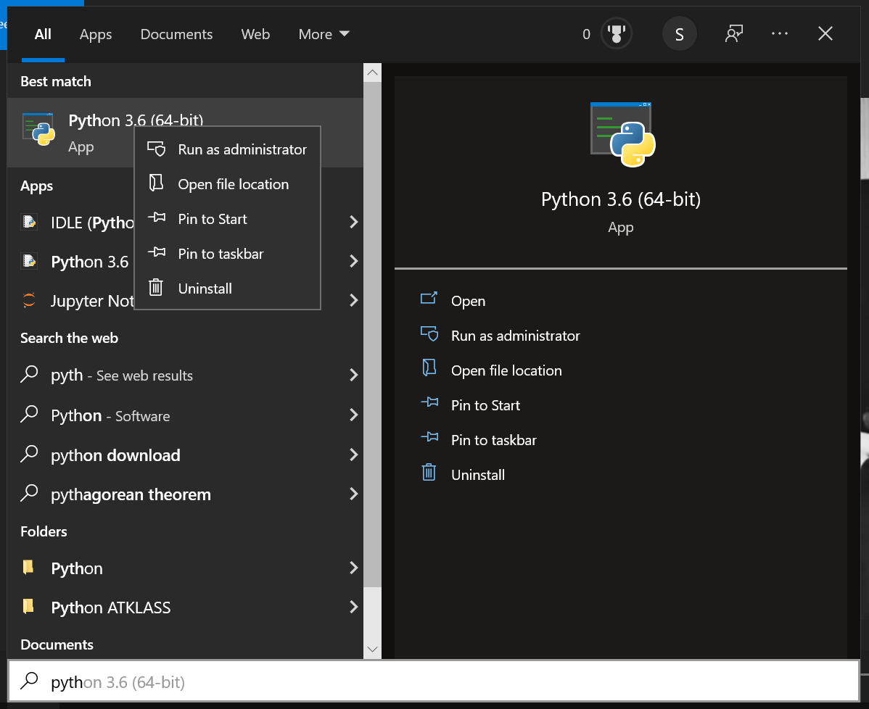
Django Installation for PyCharm
Environment Variables…
2-Right click
3
1

Slide 12
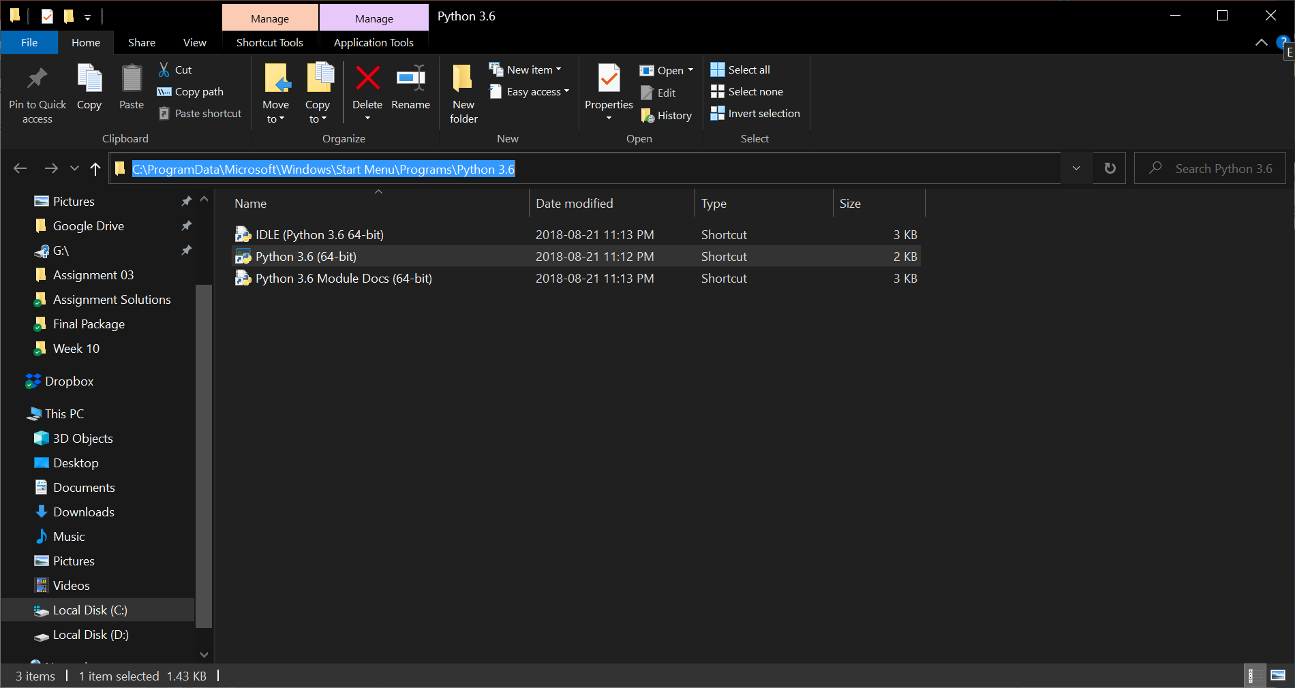
Django Installation for PyCharm
Environment Variables…
Copy this path

Slide 13
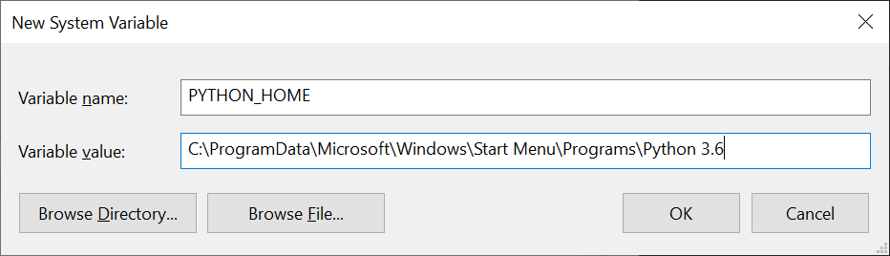
Django Installation for PyCharm
Environment Variables…
Paste
Notes:
;%PYTHON_HOME%

Slide 14
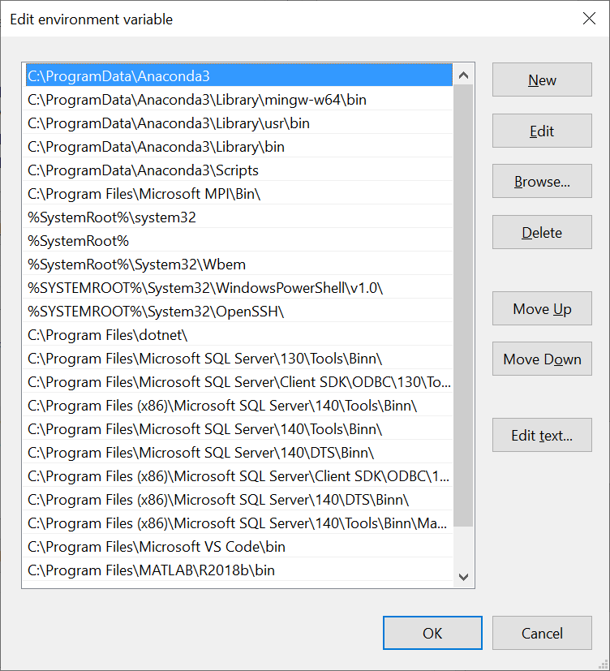
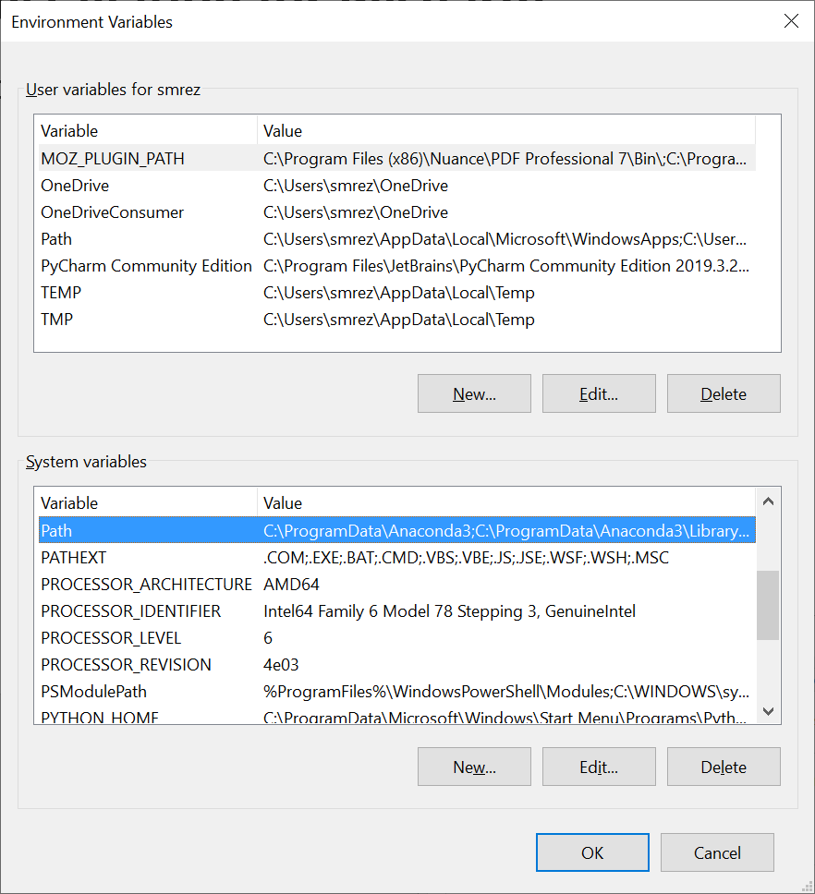
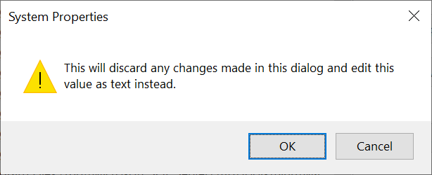
Django Installation for PyCharm
Environment Variables…
Notes:
;%PYTHON_HOME%

Slide 15
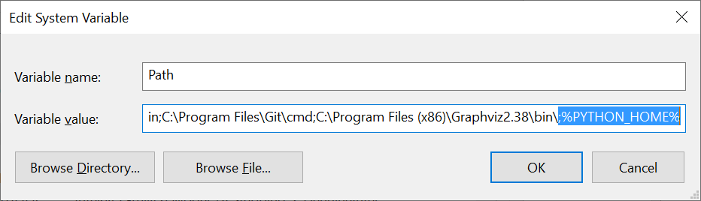
Django Installation for PyCharm
Environment Variables…
Add ;%PYTHON_HOME%
Then we press OK for all the open windows.
Notes:
;%PYTHON_HOME%

Slide 16
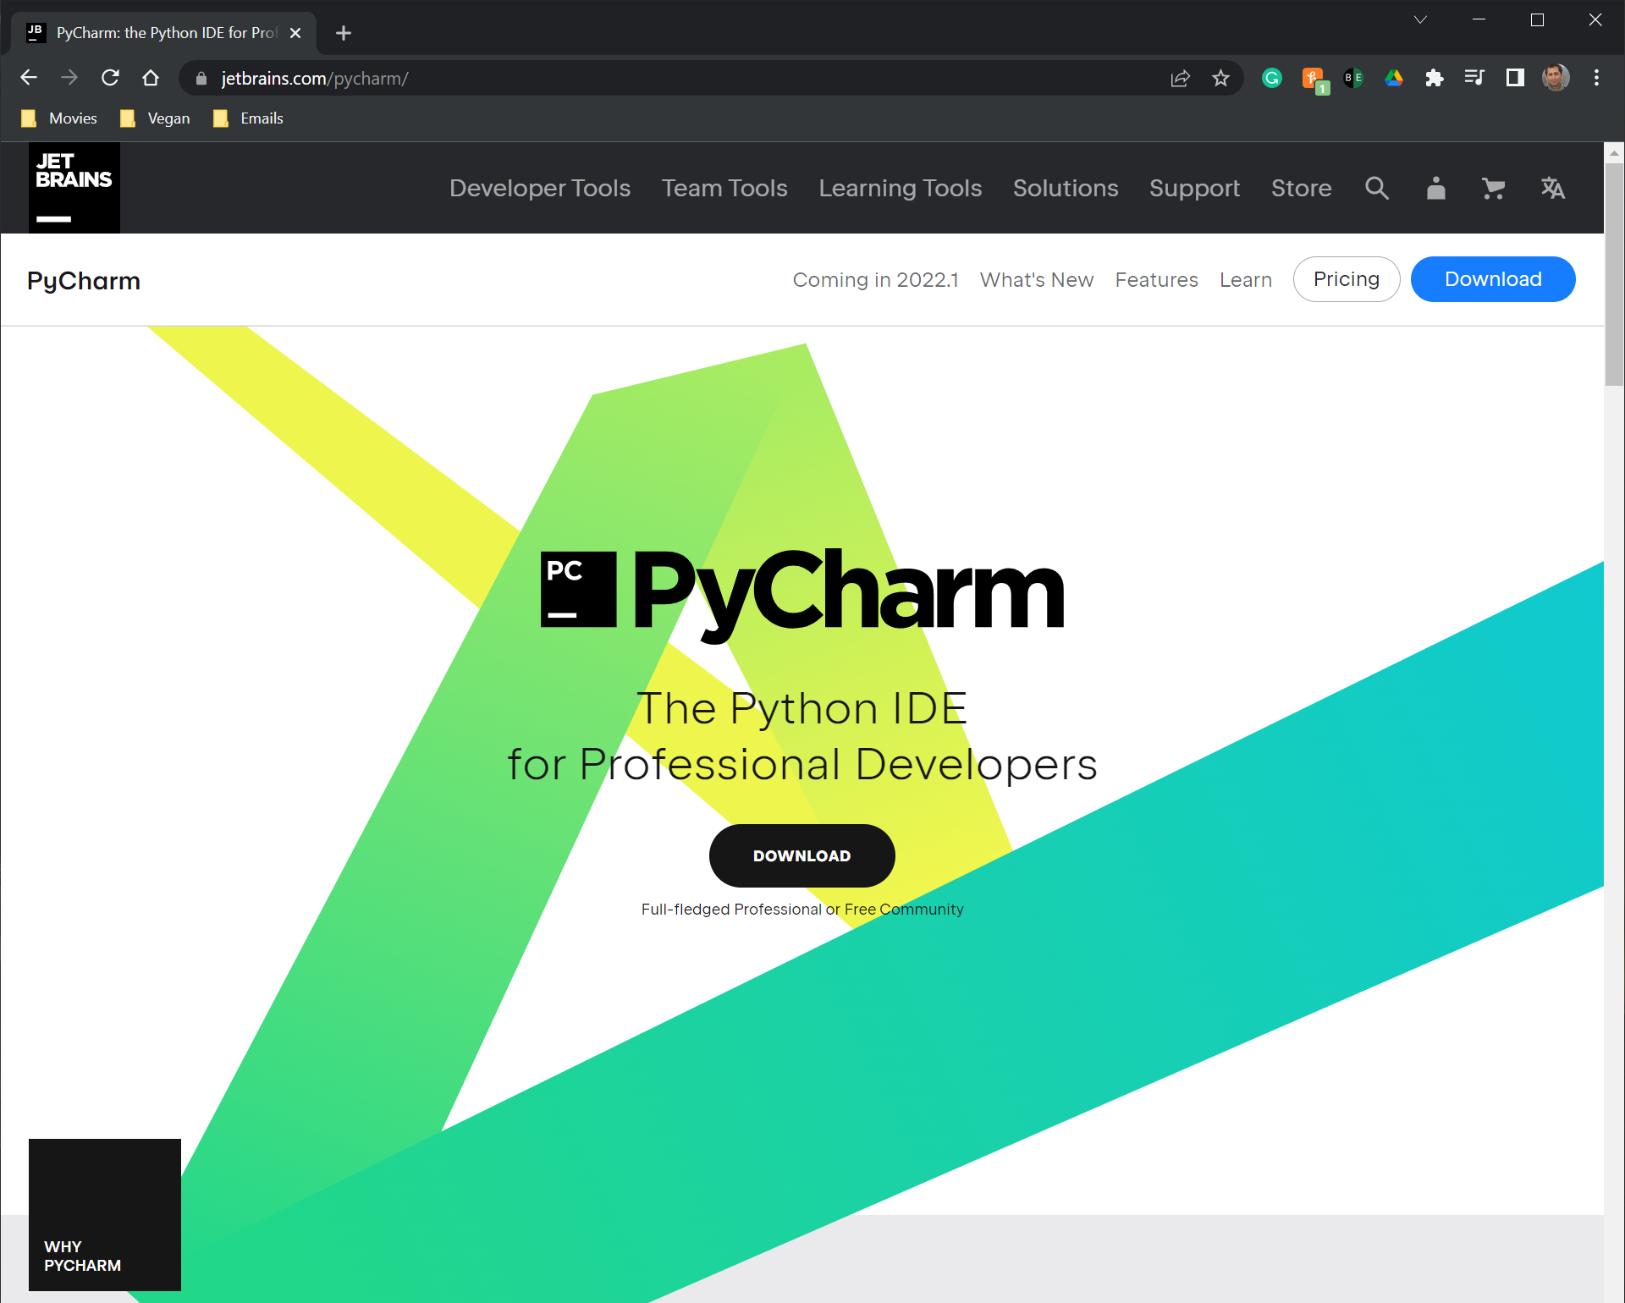
Django Installation for PyCharm
Scroll down….
Notes:
https://www.jetbrains.com/pycharm/

Slide 17
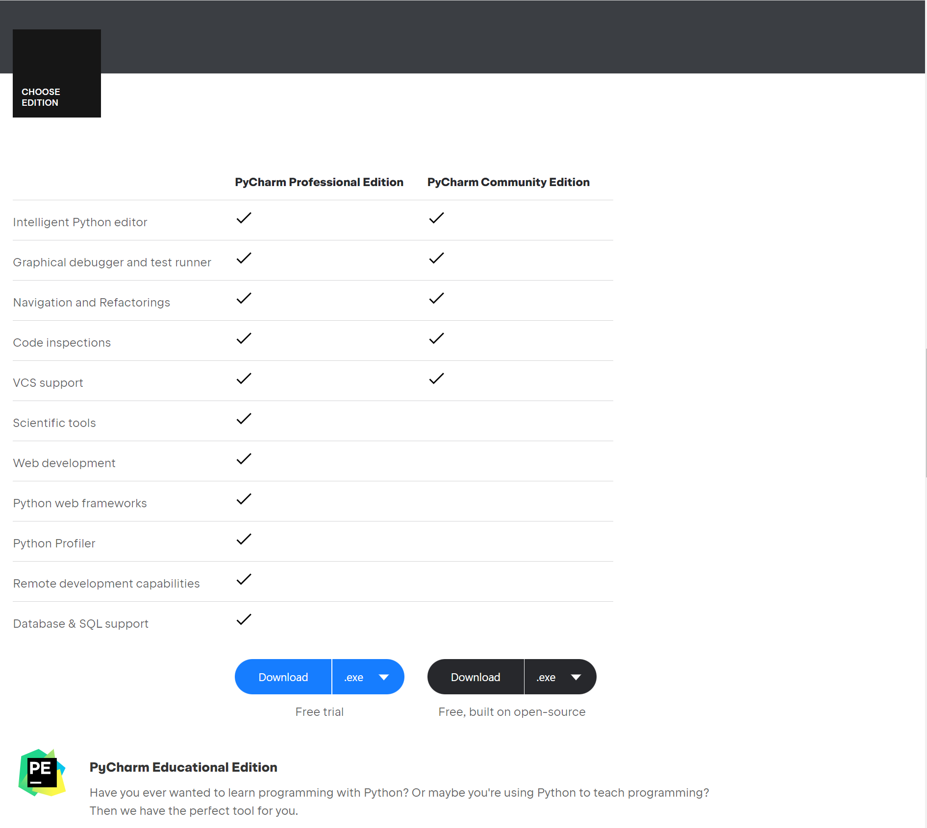
Django Installation for PyCharm
Now, we need to install and finish the set up process.
Notes:
https://www.jetbrains.com/pycharm/

Slide 18
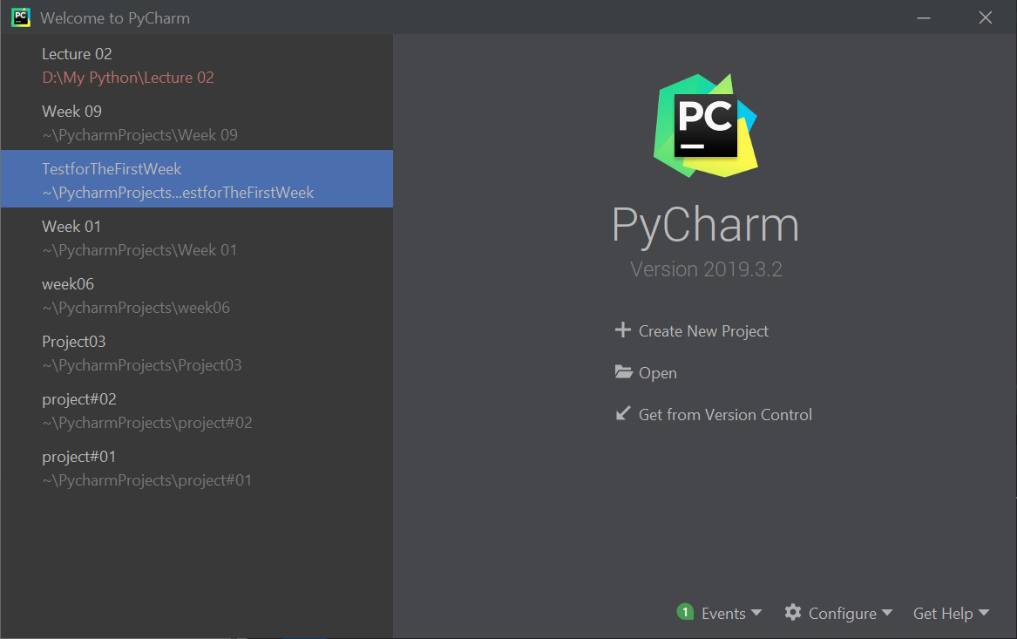
Sample Web Application Demo
Creating a new project

Slide 19
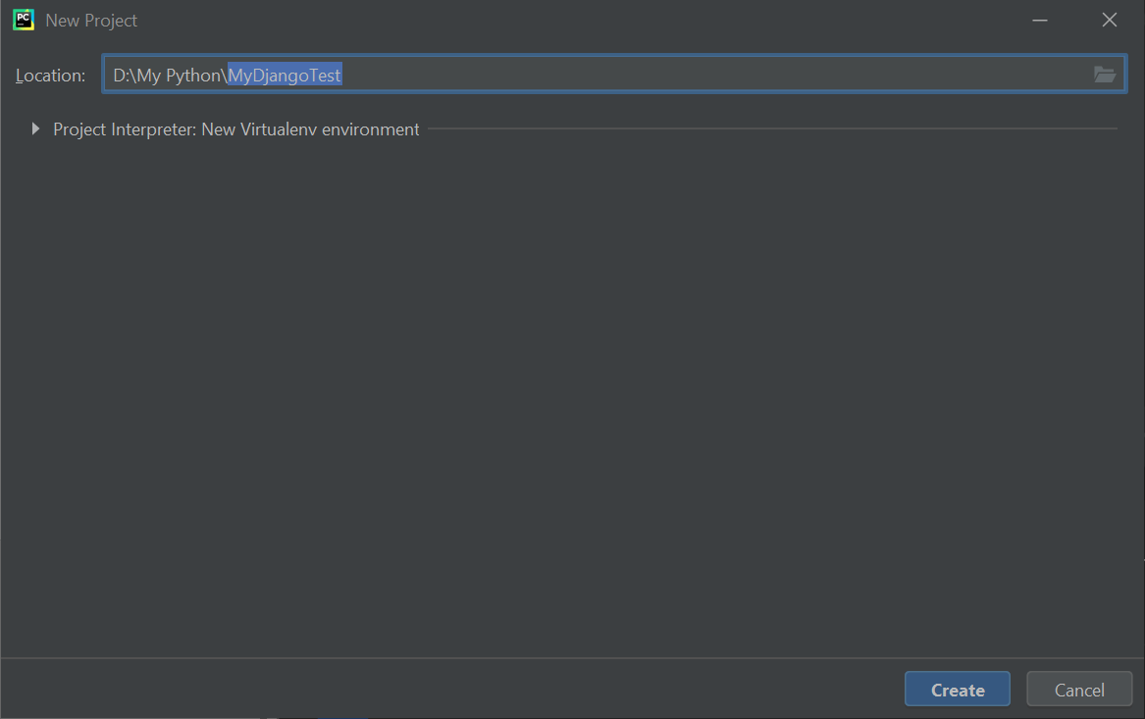
Sample Web Application Demo
Creating a new project
Notes:
MyDjangoTest

Slide 20
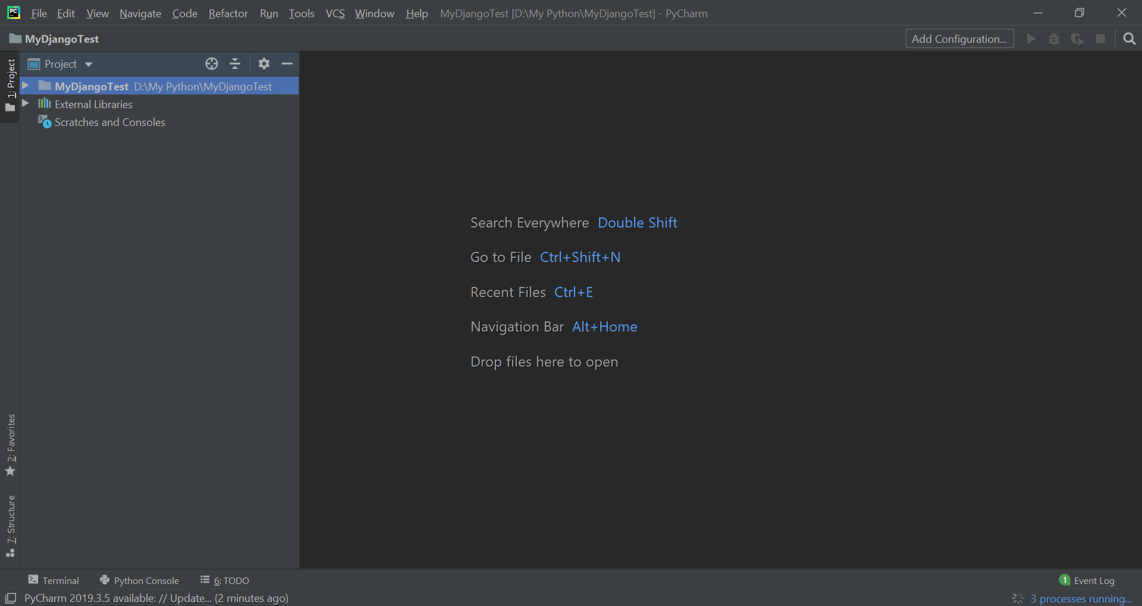
Sample Web Application Demo
Creating a new project

Slide 21
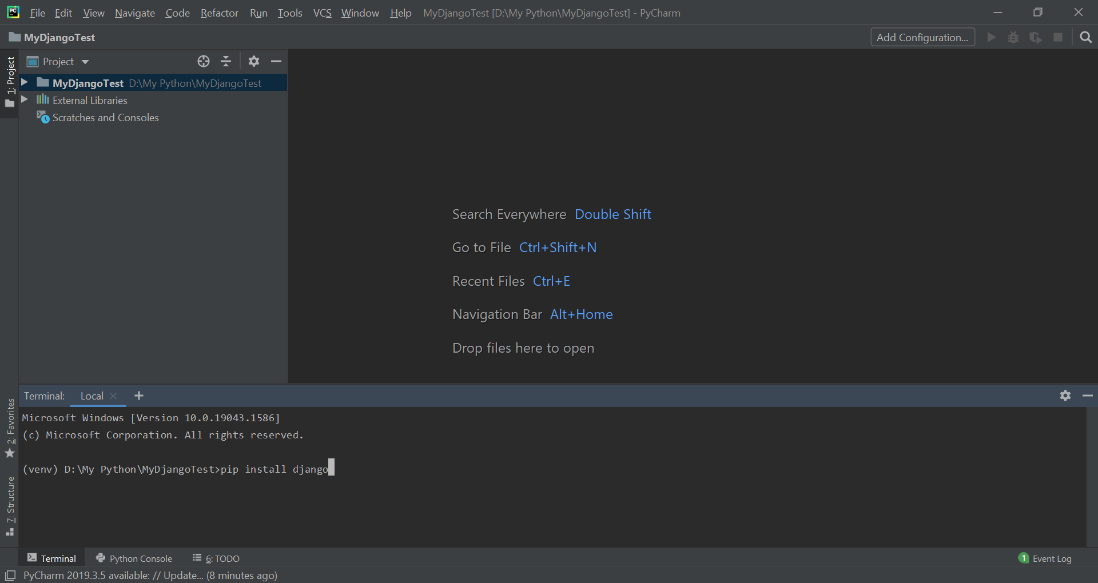
Sample Web Application Demo
pip install django
Notes:
pip install django

Slide 22
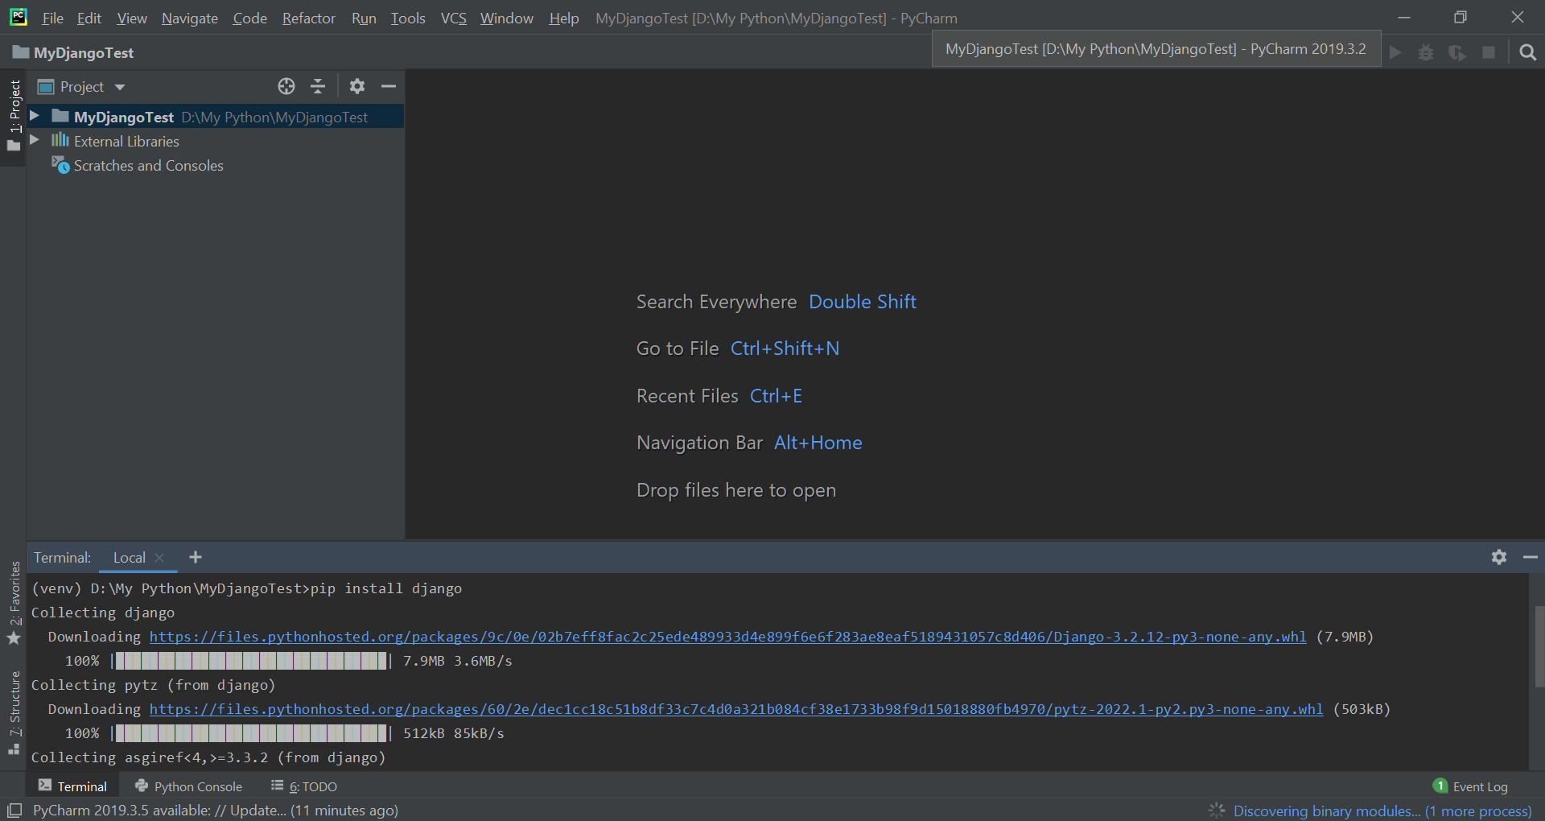
Sample Web Application Demo

Slide 23
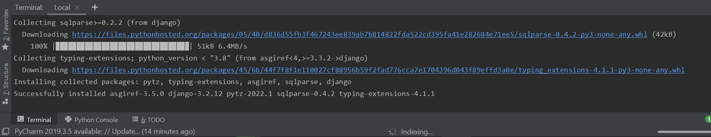
Sample Web Application Demo
Notes:
pytz: time-zone (accurate and cross-platform time calculations) solving the problem of ambiguous time.
asgiref: ASGI is a standard for Python asynchronous web apps and servers to communicate with each other, and positioned as an asynchronous successor to WSGI.
sqlparse (none-validating sql parser for Python): It provides support for parsing, splitting, and formatting SQL statements.
typing-extensions
Installing collected packages: pytz, typing-extensions, asgiref, sqlparse, django

Slide 24
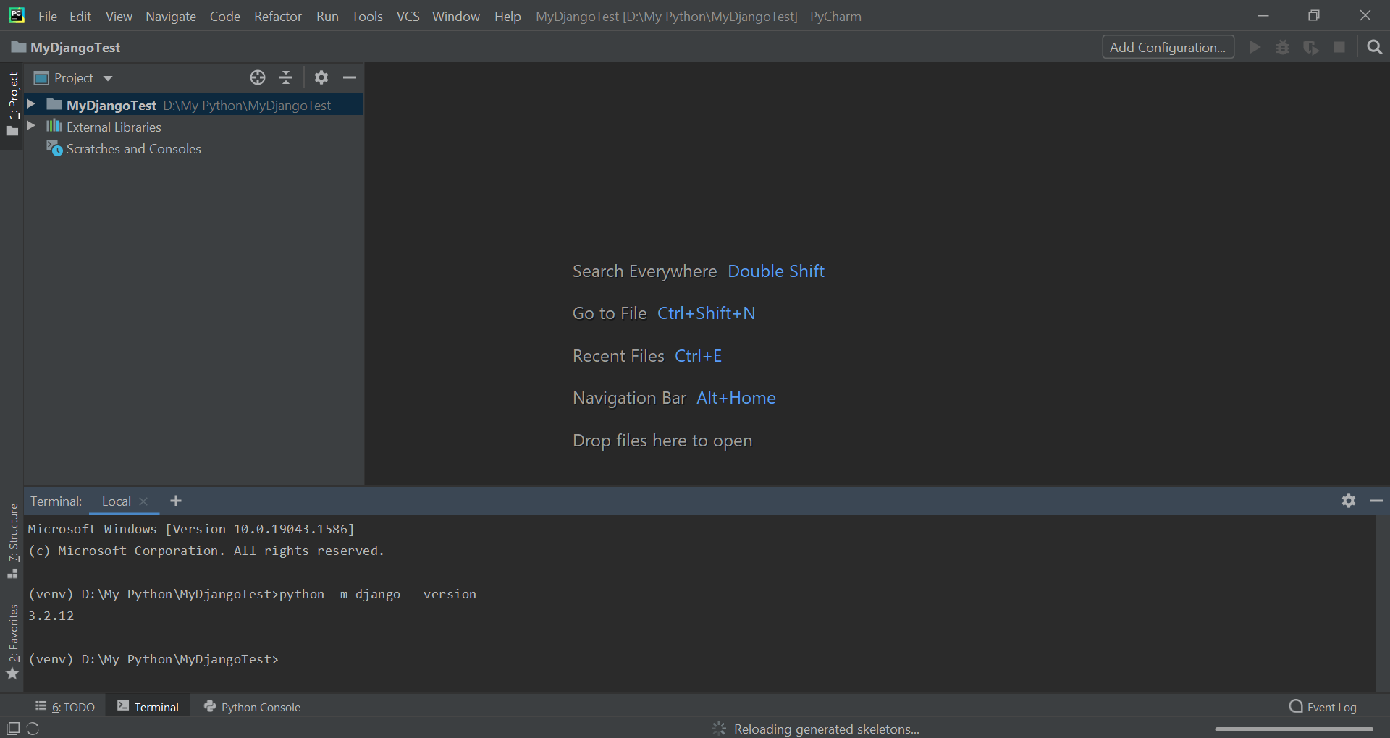
Sample Web Application Demo
Cross-checking the Django installation in command prompt:
Notes:
python -m django --version

Slide 25
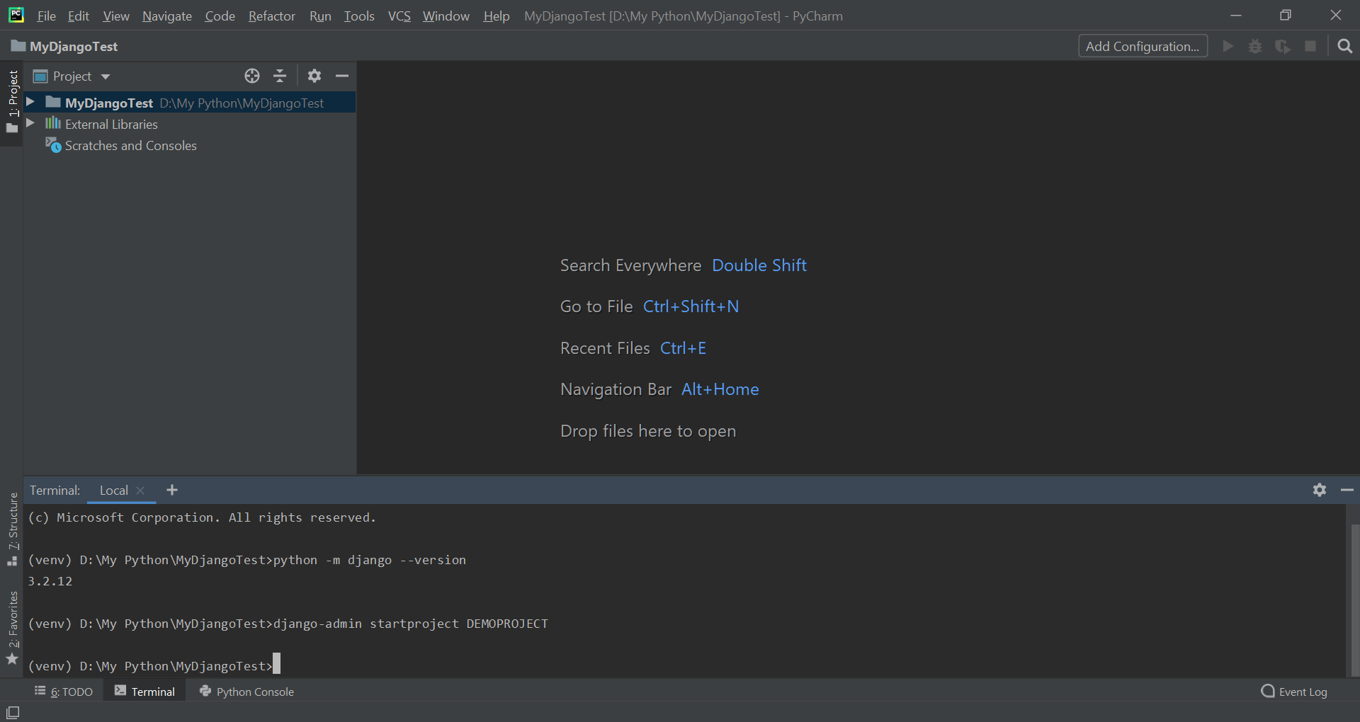
Sample Web Application Demo
Creating a project using the Terminal
Notes:
django-admin startproject DEMOPROJECT

Slide 26
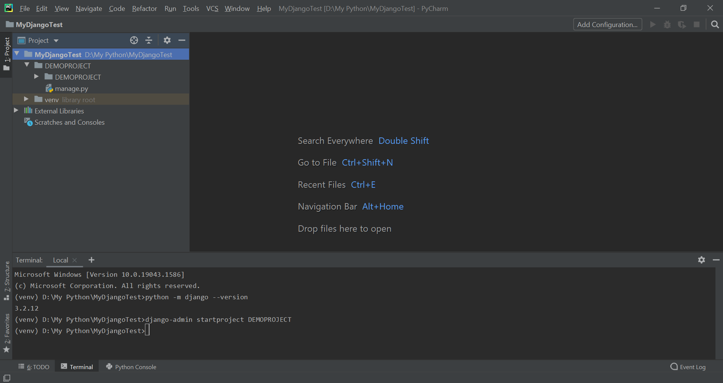
Sample Web Application Demo
Creating a project using the Terminal
Notes:
django-admin startproject DEMOPROJECT

Slide 27
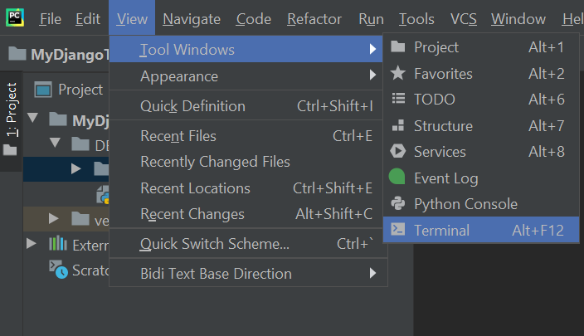
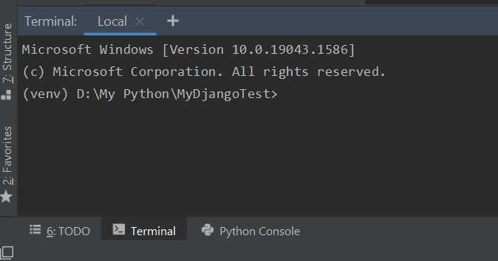
Sample Web Application Demo
View ➔ Tool Windows ➔ Terminal
Notes:
View ➔ Tool Windows ➔ Terminal

Slide 28
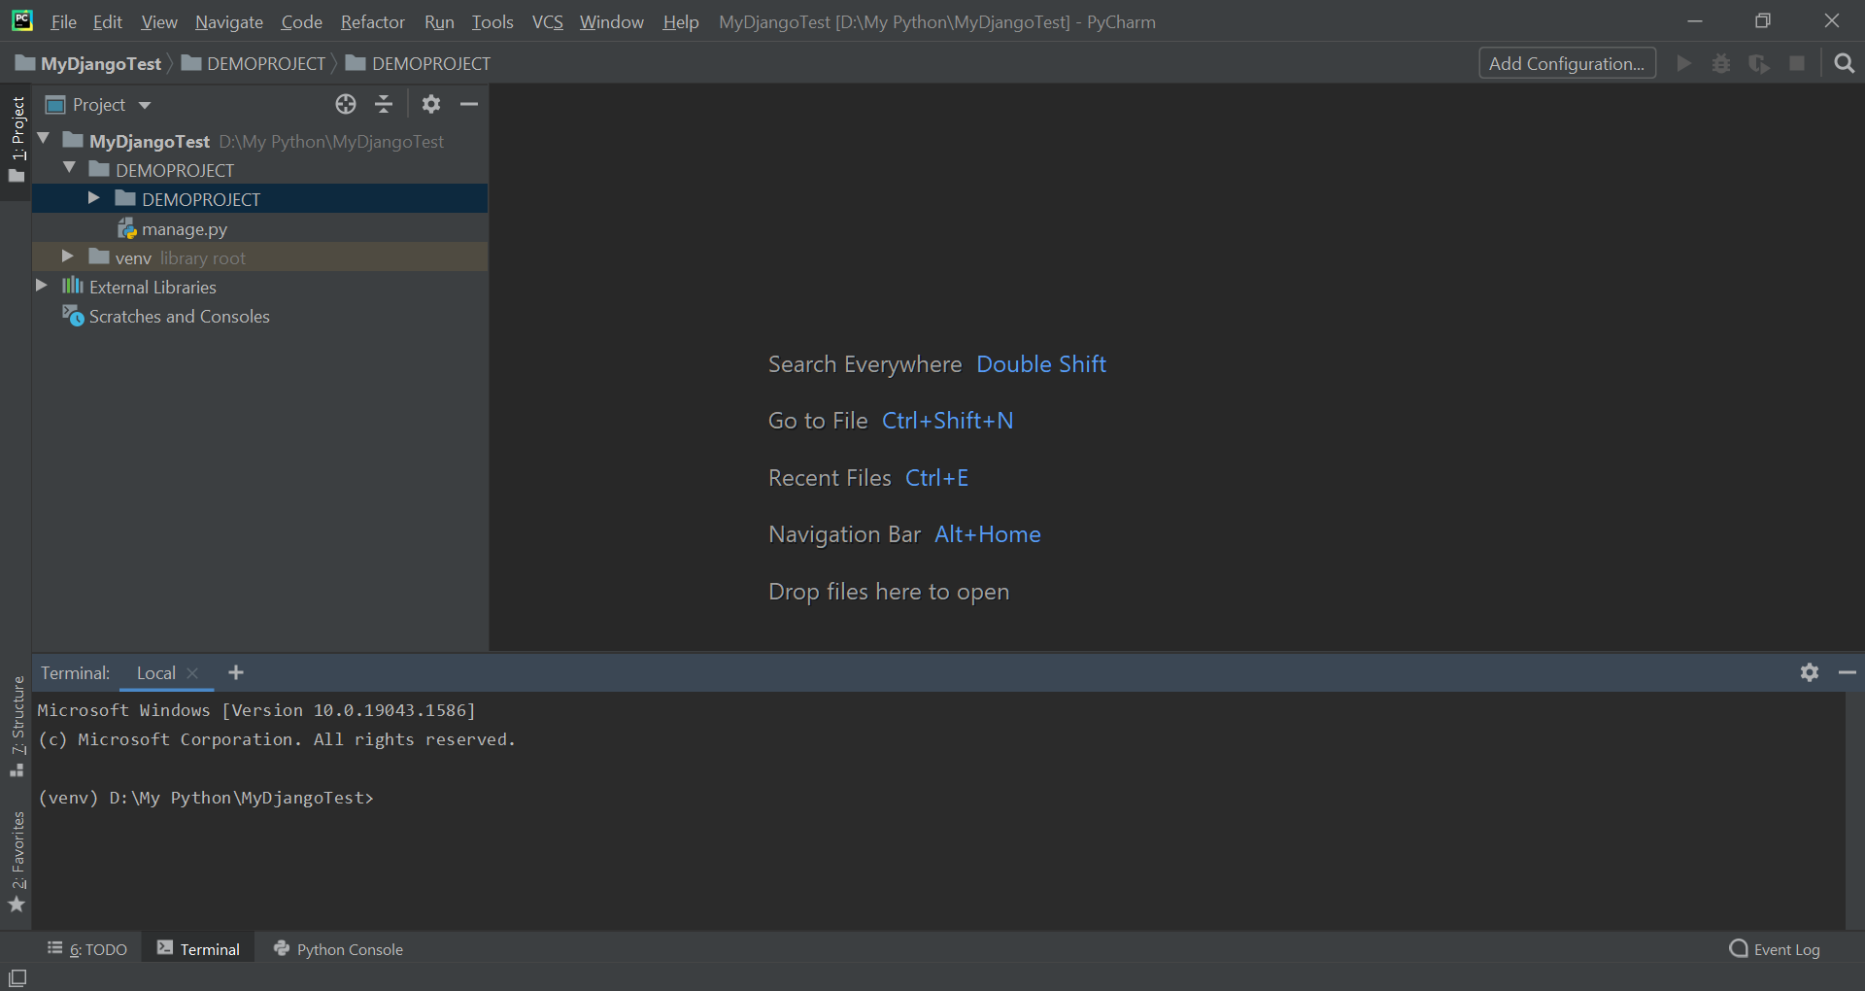
Sample Web Application Demo
What we have created so far….

Slide 29
Sample Web Application Demo
manage.py
Command line utility ➔ Interact with Django project

Slide 30
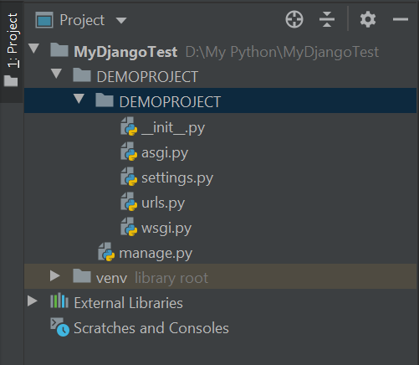
Sample Web Application Demo
Inside the created project (DEMOPROJECT)
__init__.py ➔ an empty directory, considered
to be a package
settings.py ➔ all the necessary settings for the
current project
urls.py ➔ all the url declarations for this project
wsgi.py ➔ (web server gateway interface) a calling convention for webservers to forward requests to web application or other servers

Slide 31
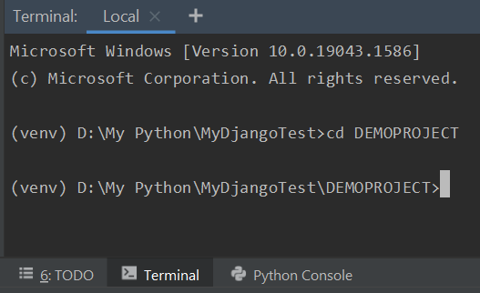
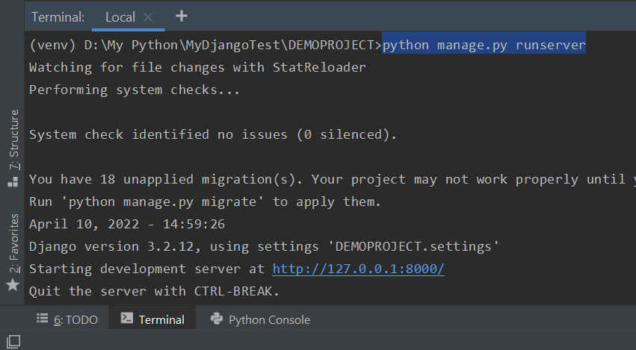
Sample Web Application Demo
How to connect from the current project to the web server
Click on this link
Notes:
cd DEMOPROJECT
python manage.py runserver

Slide 32
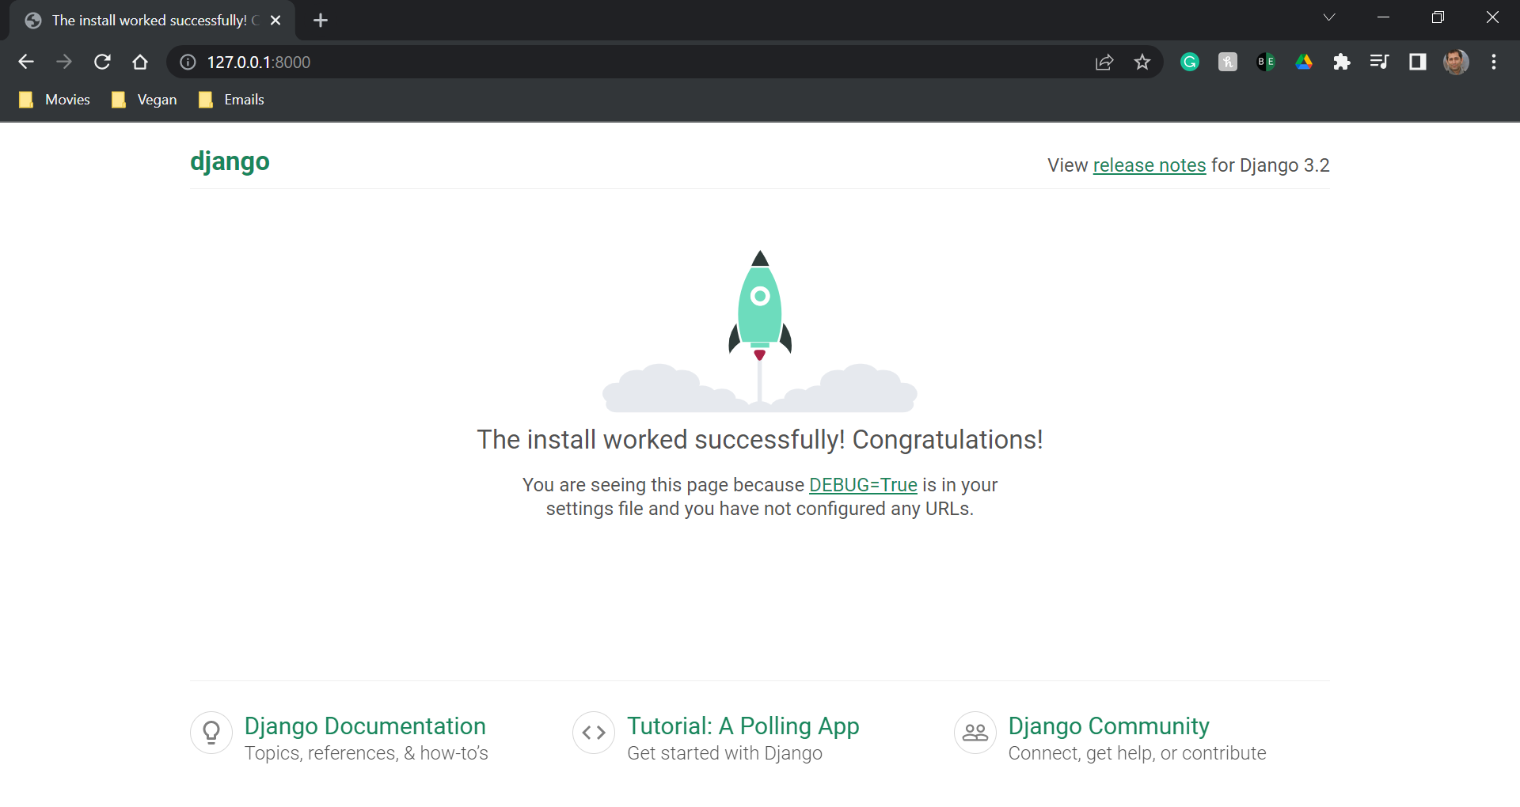
Sample Web Application Demo
Congratulations…. Your racket is ready to move….

Slide 33
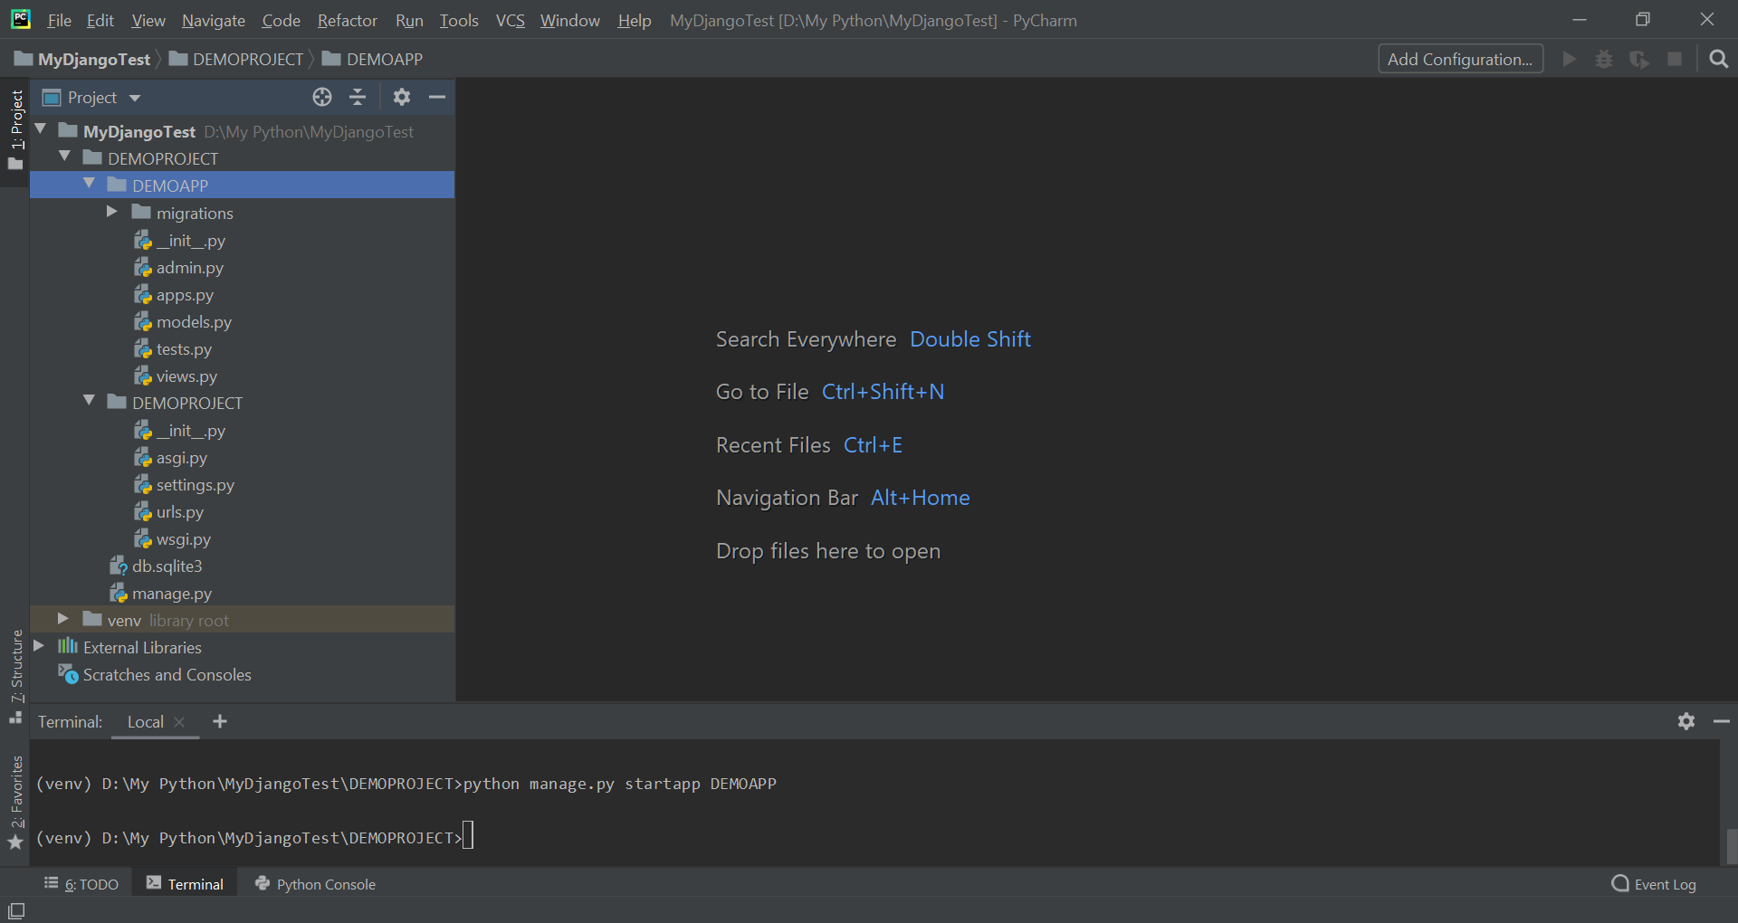
Sample Web Application Demo
Creating an app within our demo project (Ctrl + C to terminate the previous task in the terminal): Each project can have some applications.
Notes:
python manage.py startapp DEMOAPP

Slide 34
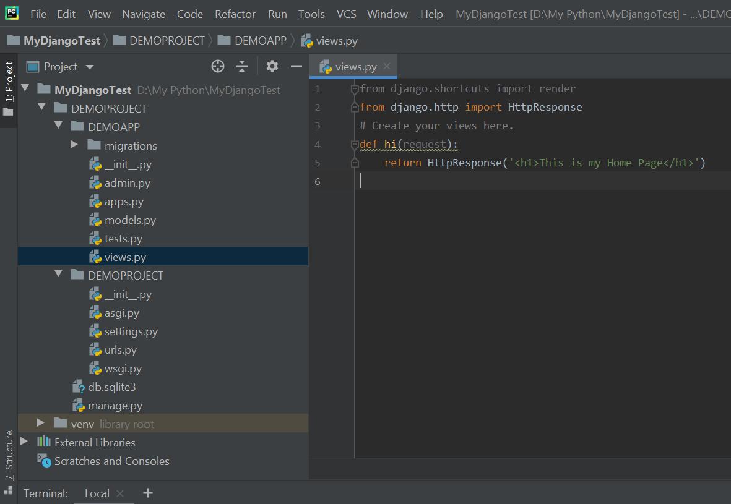
Sample Web Application Demo
Adding code to views.py
Notes:
from django.http import HttpResponse
def hi(request): return HttpResponse('<h1>This is my Home Page</h1>’)
➔ from django.shortcuts import render
is not highlighted, because we have not used render so far.

Slide 35
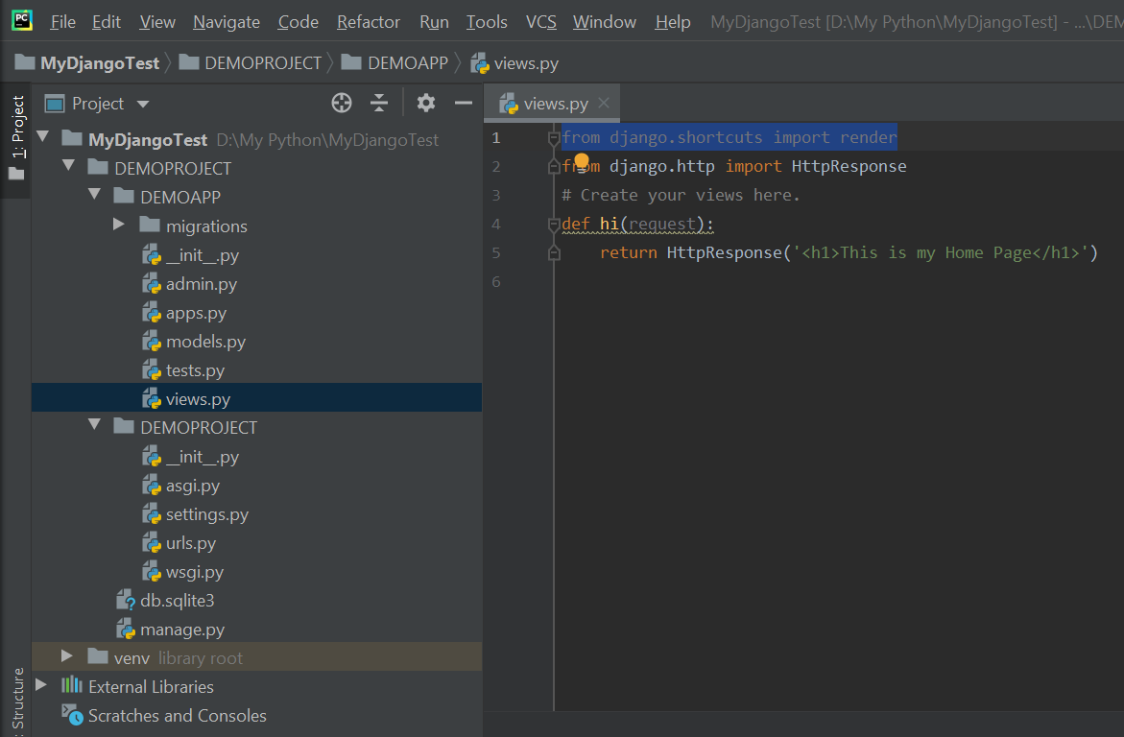
Sample Web Application Demo
Now, we need to connect urls.py in the DEMOPROJECT to views.py in the DEMOAPP

Slide 36
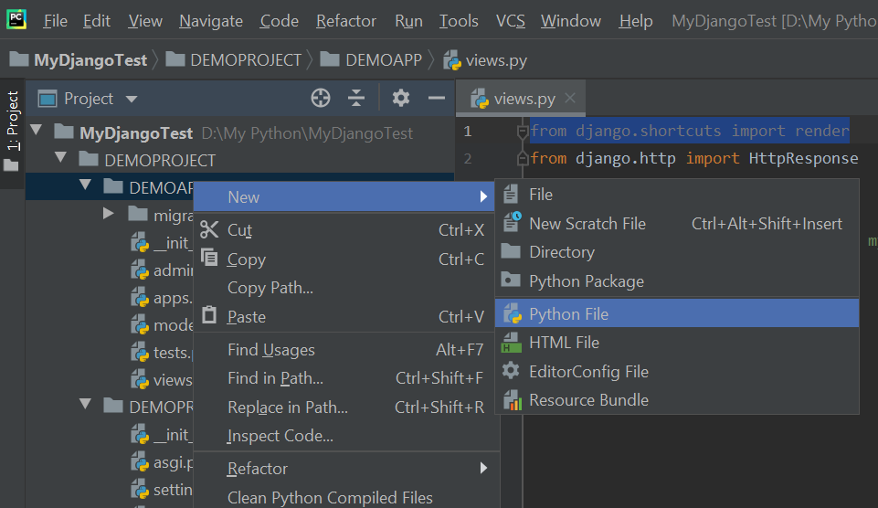
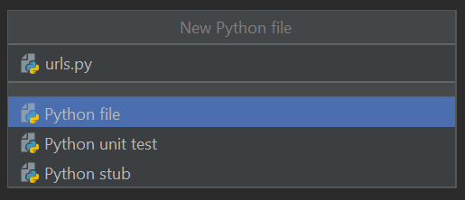
Sample Web Application Demo
To connect urls.py in the DEMOPROJECT to views.py in the DEMOAPP, we need to creating a new Python file in the DEMOAPP, called urls.py
Right-click here

Slide 37
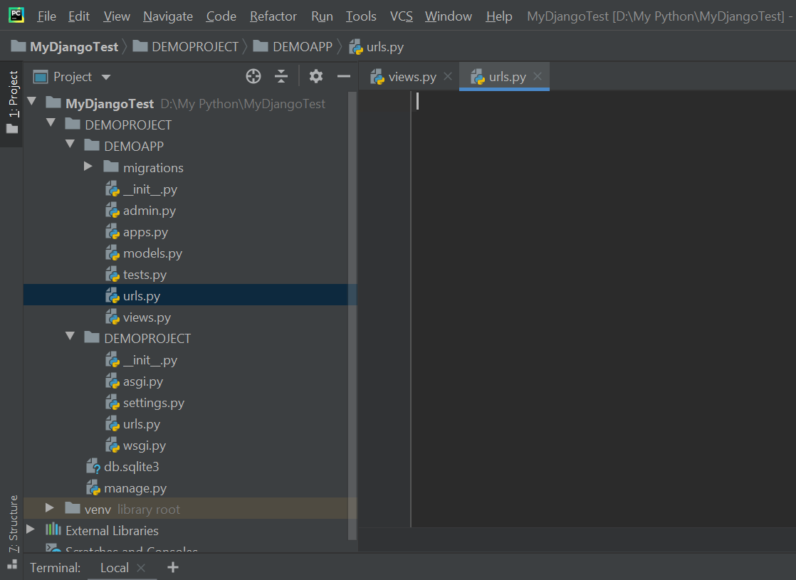
Sample Web Application Demo
The result…

Slide 38
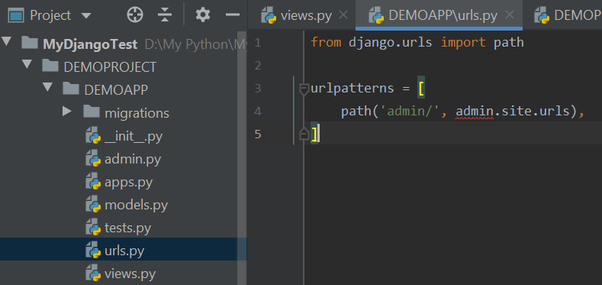
Sample Web Application Demo
Copy and pasting the following lines from DEMOPROJECT ➔ urls.py to DEMOAPP ➔ urls.py
Notes:
from django.urls import path urlpatterns = [ path('admin/', admin.site.urls), ]

Slide 39
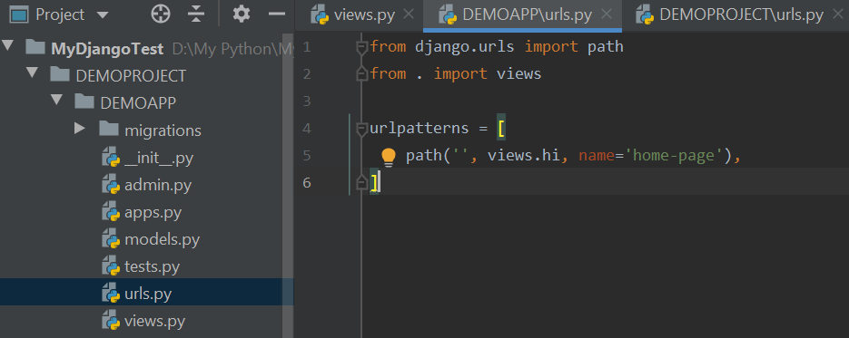
Sample Web Application Demo
Now, modify the code as follows….
Notes:
from django.urls import path from . import views urlpatterns = [ path('', views.hi, name='home-page'), ]

Slide 40
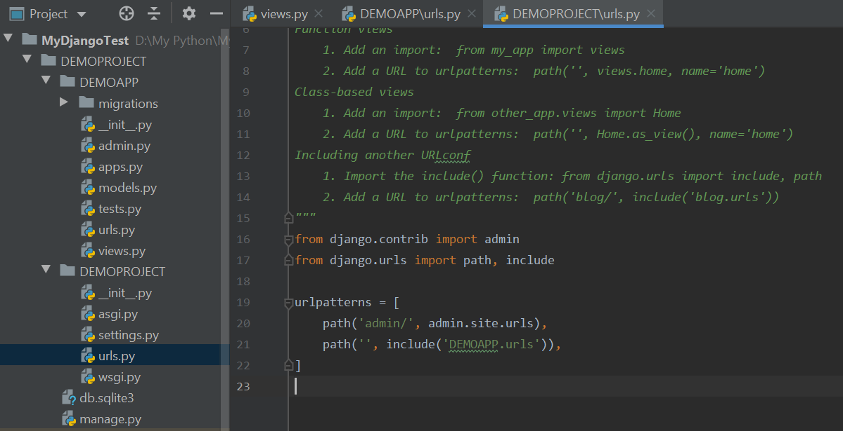
Sample Web Application Demo
The next step is to map this urls.py to the urls.py in the DEMOPROJECT
Notes:
from django.contrib import admin from django.urls import path, include urlpatterns = [ path('admin/', admin.site.urls), path('', include('DEMOAPP.urls')), ]

Slide 41
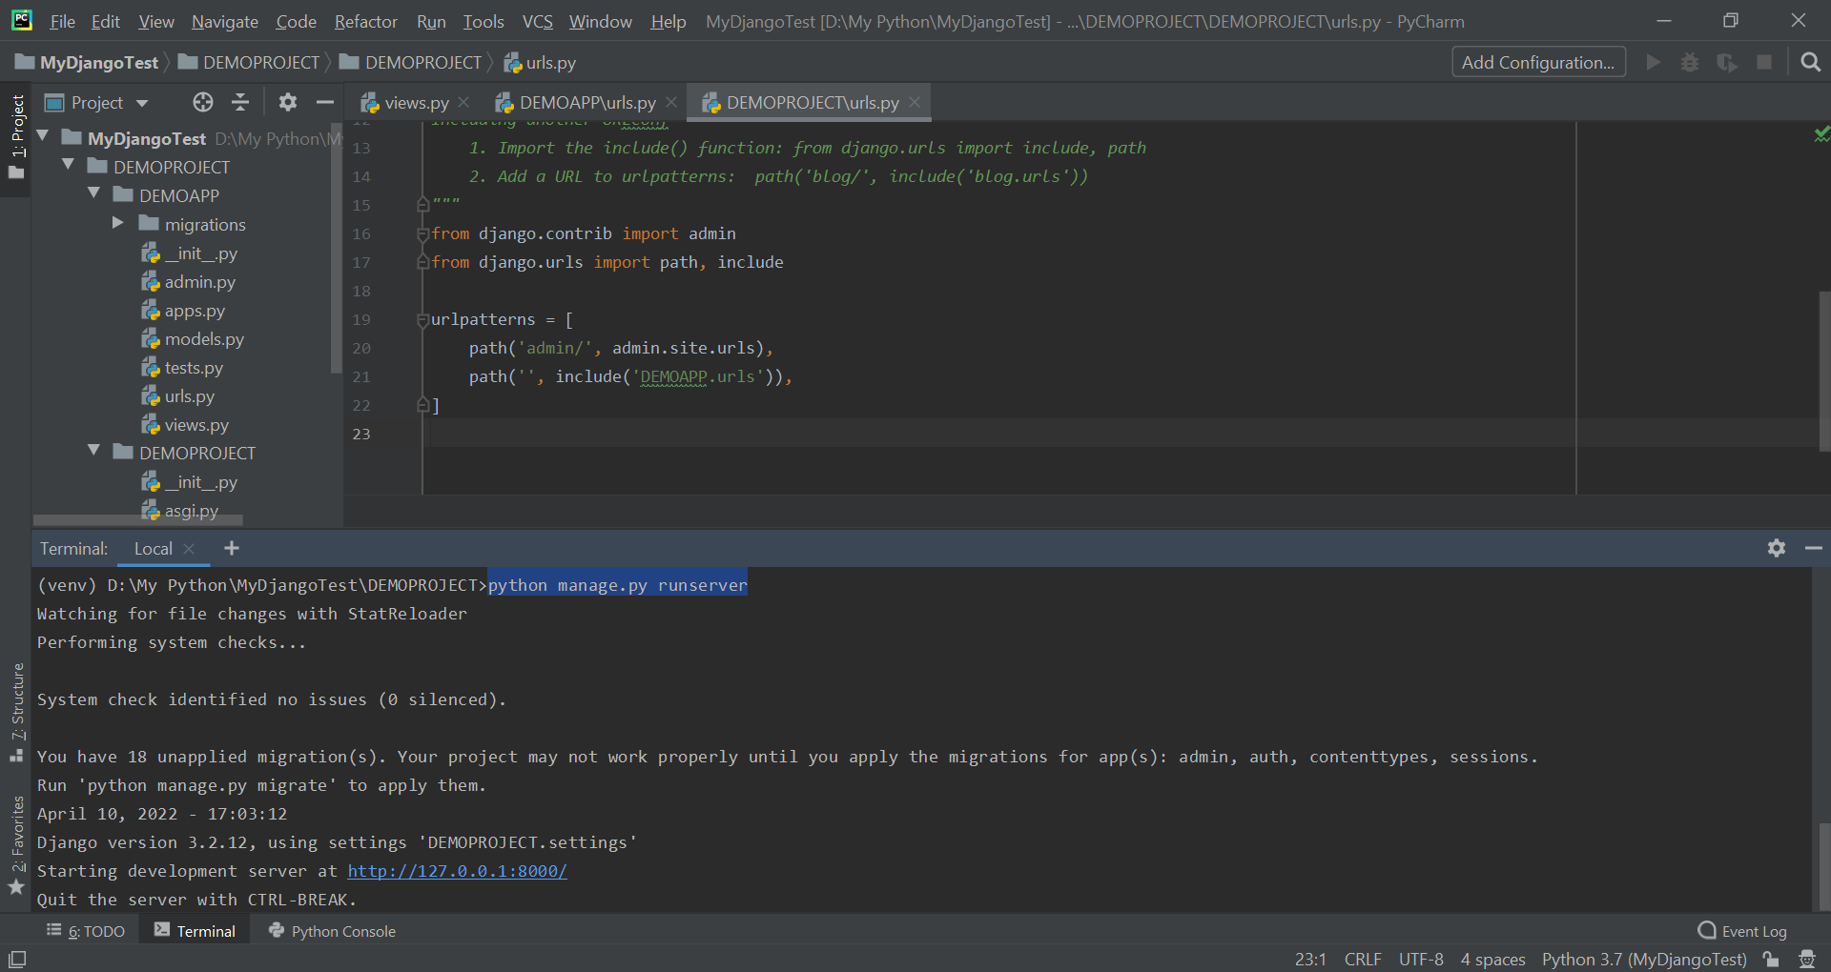
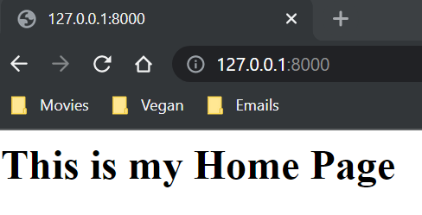
Sample Web Application Demo
Getting to command line and running the runserver again….
And clicking on the link.
Notes:
python manage.py runserver

Slide 42
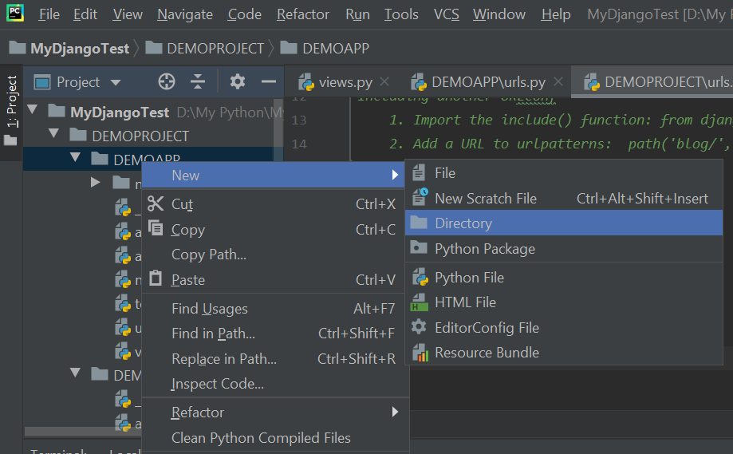
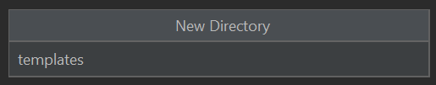
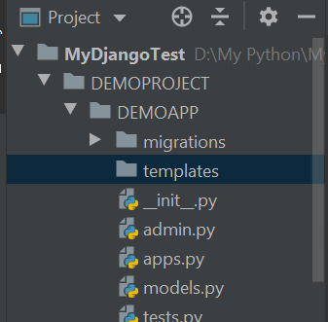
Sample Web Application Demo
We get back to PyCharm to modify our code and create our website.
Django will look into this directory for necessary templates.
Right-click here

Slide 43
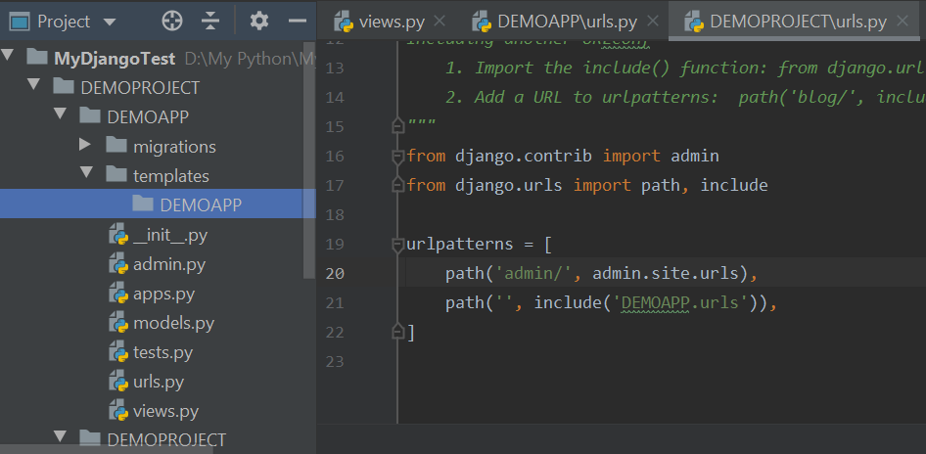
Sample Web Application Demo
Within the templates directory, we create another directory with our app name: DEMOAPP
Right-click on templates ➔ New ➔ Directory ➔ DEMOAPP

Slide 44
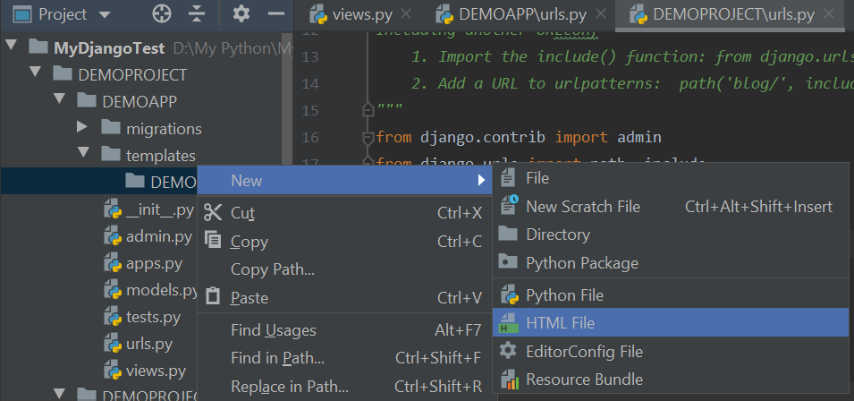

Sample Web Application Demo
We create a hi.html file inside the templates folder.
Right-click here

Slide 45

Sample Web Application Demo
And here is the result….

Slide 46

Sample Web Application Demo
A bit changing in the code….
Notes:
<!DOCTYPE html> <html lang="en"> <head> <meta charset="UTF-8"> <title>COMP 2152</title> </head> <body> <h1>Hello from Reza!</h1> </body> </html>

Slide 47

Sample Web Application Demo
Going to apps.py ➔ Copying DemoappConfig
Notes:
DemoappConfig

Slide 48

Sample Web Application Demo
Opening the settings.py, and applying the following changes….
Notes:
'DEMOAPP.apps.DemoappConfig’,

Slide 49

Sample Web Application Demo
Getting back to views.py, and applying the following changes….
Notes:
from django.shortcuts import render from django.http import HttpResponse # Create your views here. def hi(request): return render(request, 'DEMOAPP/hi.html')

Slide 50


Sample Web Application Demo
In the terminal, we run the python manage.py runserver command again….
Then, clicking on the link….
Notes:
python manage.py runserver

Slide 51

Sample Web Application Demo
Getting back to hi.html, and modifying our html code….

Slide 52


Sample Web Application Demo
Modifying the following code…. Then, refreshing the page.
Notes:
<!DOCTYPE html> <html lang="en"> <head> <meta charset="UTF-8"> <title>COMP 2152</title> </head> <body> <h1>Welcome to Reza's page!</h1> <h1>This is my website!</h1> <ul> <li>Python</li> <li>C#</li> <li>Java</li> </ul> </body> </html>

Slide 53


Sample Web Application Demo
Now, creating a table….
Notes:
<table> <tr> <th>Company</th> <th>Contact</th> <th>Country</th> </tr> <tr> <td>Alfreds Futterkiste</td> <td>Maria Anders</td> <td>Germany</td> </tr> <tr> <td>Centro comercial Moctezuma</td> <td>Francisco Chang</td> <td>Mexico</td> </tr> </table>

Slide 54


Sample Web Application Demo
Changing a bit of style here and there….
Notes:
<!DOCTYPE html> <html lang="en"> <head> <meta charset="UTF-8"> <title>COMP 2152</title> <style>table,th,td {border:1px solid black;</style> </head> <body> <h1>Welcome to Reza's page!</h1> <h1>This is my website!</h1> <ul> <li>Python</li> <li>C#</li> <li>Java</li> </ul> <table style="width:50%"> <tr> <th>Company</th> <th>Contact</th> <th>Country</th> </tr> <tr> <td>Alfreds Futterkiste</td> <td>Maria Anders</td> <td>Germany</td> </tr> <tr> <td>Centro comercial Moctezuma</td> <td>Francisco Chang</td> <td>Mexico</td> </tr> </table> </body> </html>

Slide 55

Sample Web Application Demo
Going to bootsrap and adding more frills to our website….
Notes:
https://getbootstrap.com/docs/5.1/getting-started/introduction/
<link href="https://cdn.jsdelivr.net/npm/bootstrap@5.1.3/dist/css/bootstrap.min.css" rel="stylesheet" integrity="sha384-1BmE4kWBq78iYhFldvKuhfTAU6auU8tT94WrHftjDbrCEXSU1oBoqyl2QvZ6jIW3" crossorigin="anonymous">

Slide 56

Sample Web Application Demo
Adding the copied code to the hi.html as follows:
Notes:
<link href="https://cdn.jsdelivr.net/npm/bootstrap@5.1.3/dist/css/bootstrap.min.css" rel="stylesheet" integrity="sha384-1BmE4kWBq78iYhFldvKuhfTAU6auU8tT94WrHftjDbrCEXSU1oBoqyl2QvZ6jIW3" crossorigin="anonymous">

Slide 57

Sample Web Application Demo
And, here is the result ☺

Slide 58

Just a bit of Flask
How about watching these quick videos?
https://www.youtube.com/watch?v=F7AK-WzpYdY
https://www.youtube.com/watch?v=mqhxxeeTbu0
https://www.youtube.com/watch?v=6plVs_ytIH8

Slide 59

What is REST API?
How about watching a video about REST API?
https://www.youtube.com/watch?v=SLwpqD8n3d0

Slide 60

Thank you
Question?
To be
Not to be

